Slide 1

REAL ESTATE
Sprint 1&2
Presented By:
Varshitha N

Slide 2
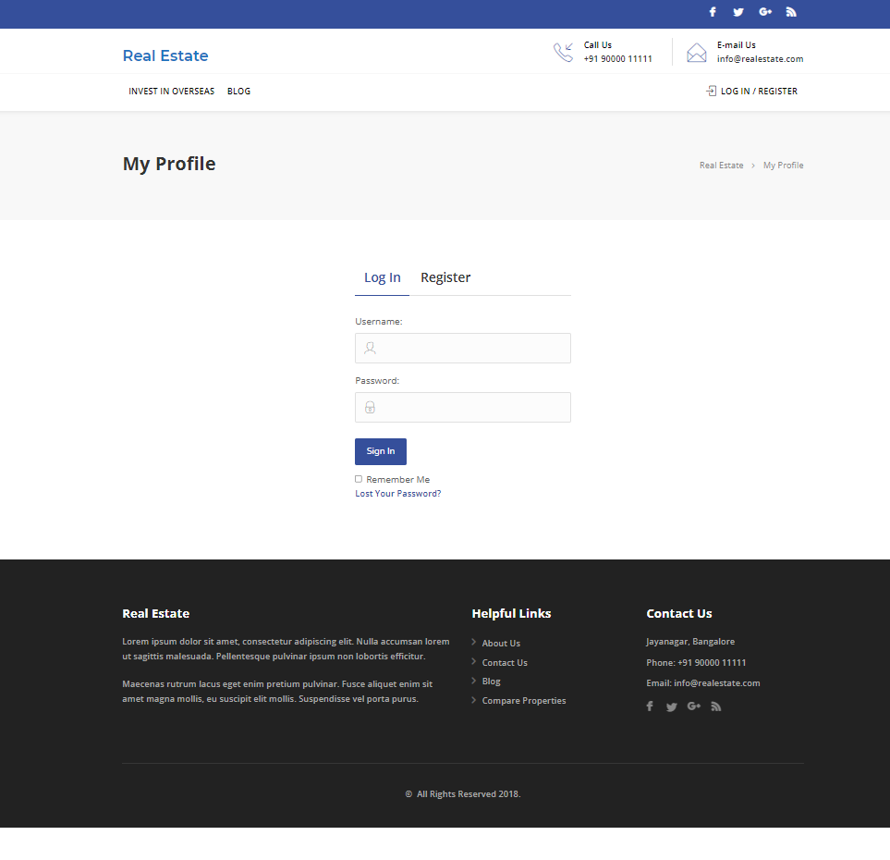
Real Estate website
Welcome to Real Estate

Slide 3
FEATURES
Admin
Login
Profile
Dashboard
Comments
user-all, new, profile
Post-all post
Media-library, add new
property-add new
User
Register/Login
Homepage
Profile
Property management-contact form
Search property
Bookmark
For enquires
Change password

Slide 4
Manual testing - sprint 1
Activities
Planning-User stories in Jira
Work allocation- For test design to team members- Jira tasks
Test design process-
Scenarios- categorised based on business risks
Test cases and equivalence partition was created
Pre-conditions and specification for data creation
Review process and execution.

Slide 5
Sprint 1
Change password and property management contact form functionalities was assigned by scrum master.
Stories and task for change password and property management contact form was created in Jira.
Test cases for change password and property management contact form was created in excel.
Test cases were reviewed and executed.
Defects and issues which were found during the execution of test cases and were noted down.
Bugs were created in Jira.

Slide 6
Jira – Workflow in Sprint 1
2 Stories were created in Jira with respect to Admin side and user side
No of tasks & sub-tasks- 4
Review of each task was completed.
Execution of the testcase was submitted.
Defects were logged into the defect log
Issue log was created

Slide 7
Automation testing - Sprint 2
Planning activities-selection of test cases for automation under
Smoke test
Sanity test
Regression test
Task allocation for automation test cases to automation testers
Techniques followed - Selenium , Java ,Maven, TestNG, Page Object Model, frameworks selected for the automation

Slide 8
Sprint 2
USER
1. Regression Test -Change Password
2. Regression Test - Property management-contact form
Automation of change password and property management contact form was done using eclipse.
Selenium , Java ,Maven, TestNG, Page Object Model, frameworks selected for the automation.
Screenshots of non-functional commands were taken and defects were noted down.
TestNG reports were generated.

Slide 9
Jira – Workflow in Sprint 2
2 Stories were created in Jira with respect to Admin side and user side
Sprint 2 -
No of tasks & sub-tasks- 2
Defects were logged into the defect log
Issue log was created

Slide 10
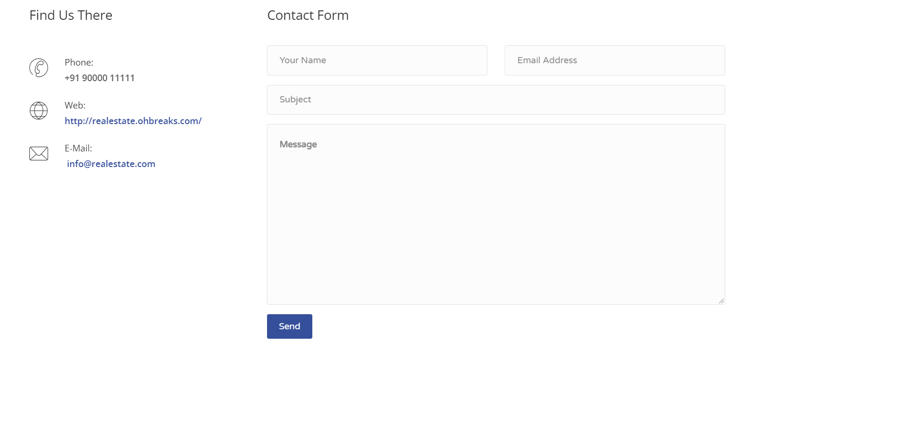
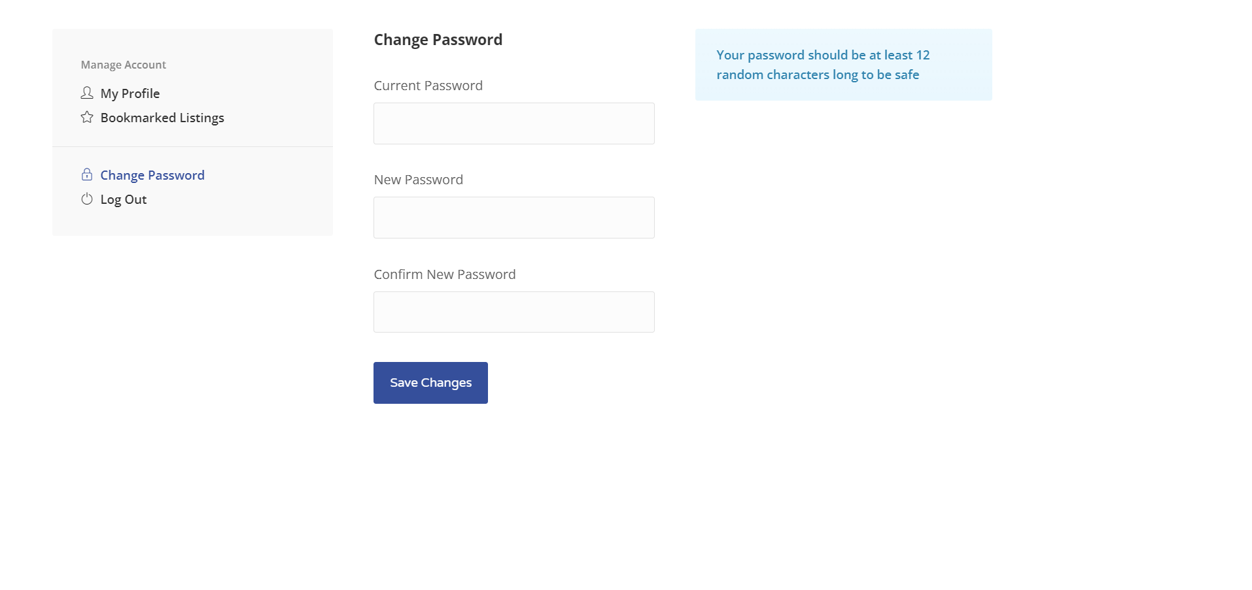
Real Estate website
Property Management Contact Form and Change Password

Slide 11
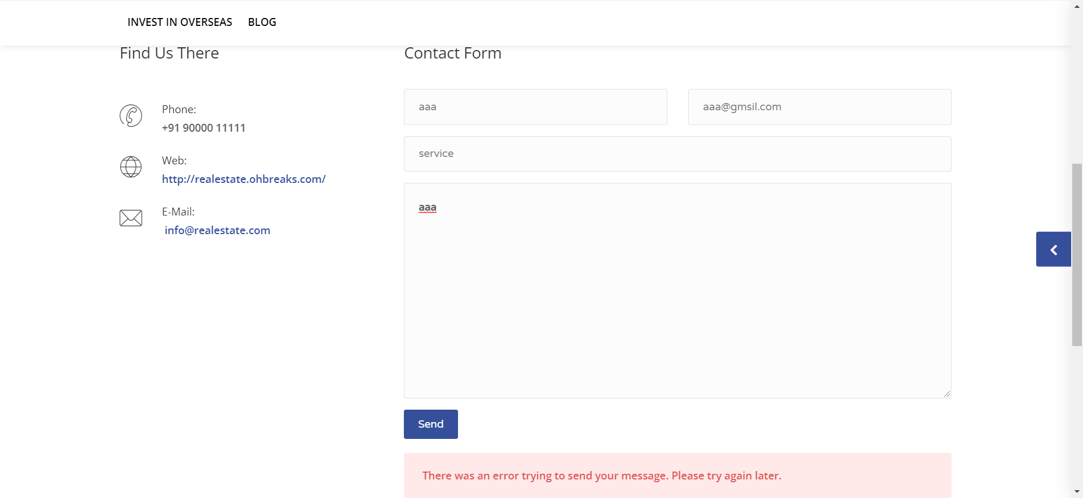
Real Estate website
Screenshots
Of Non-functional Commands

Slide 12
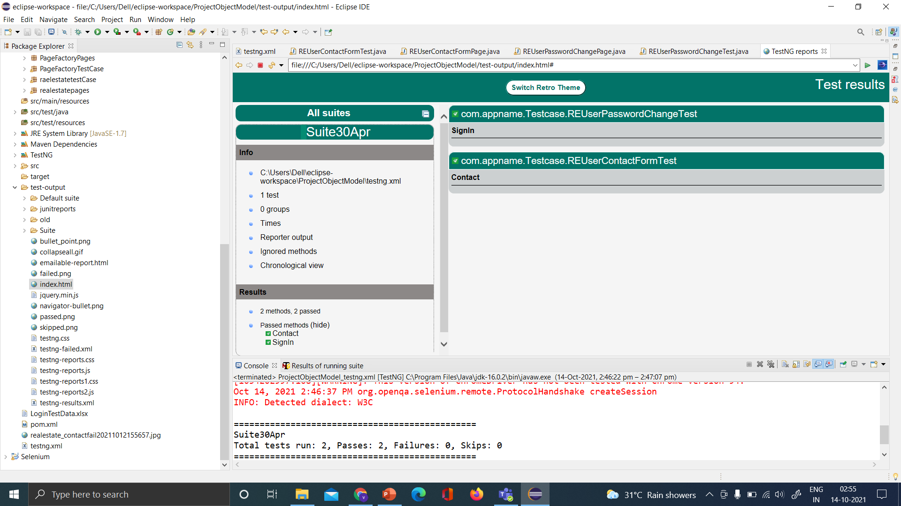
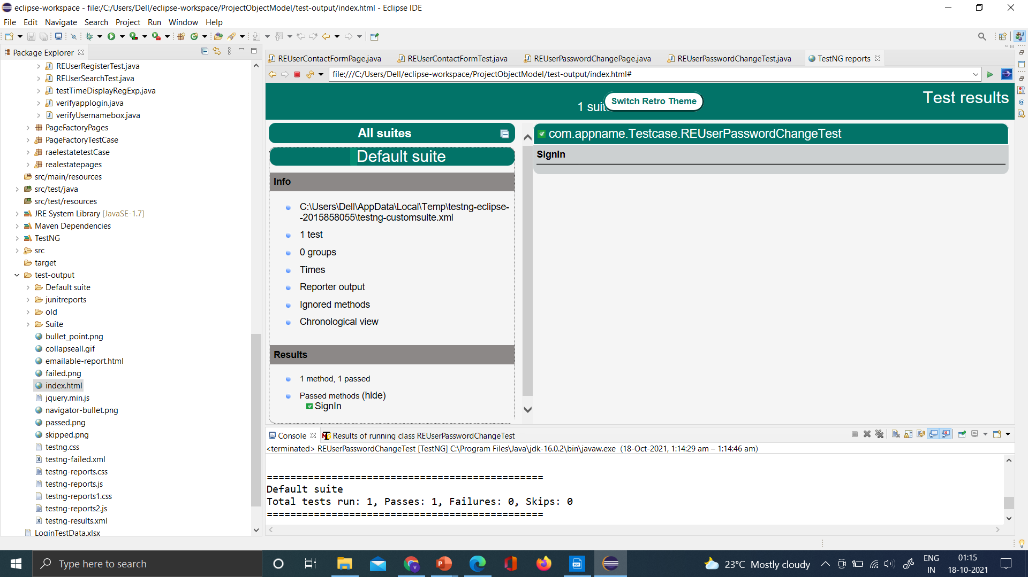
Real Estate website
TestNG Report

Slide 13
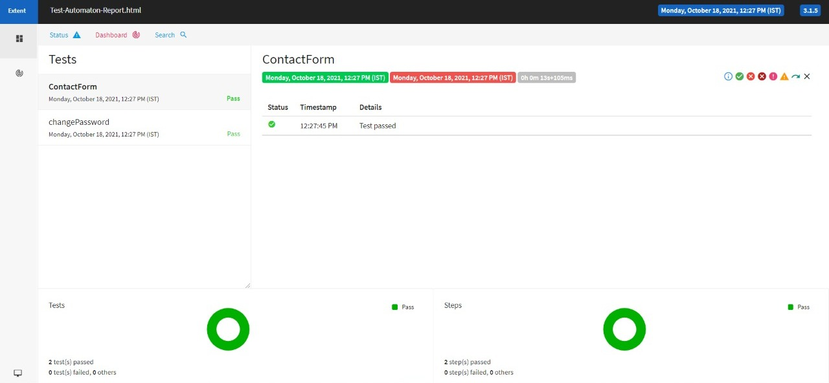
Real Estate website
Extent Report

Slide 14
THANK YOU

